Slide 1
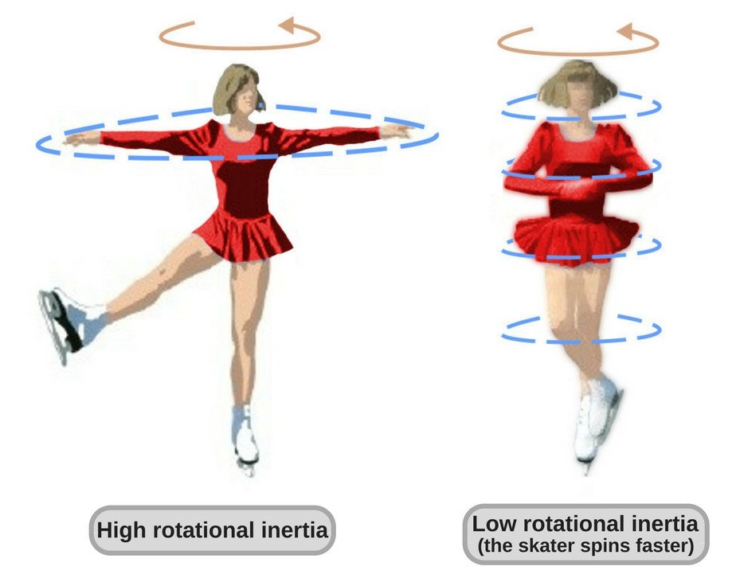
Rotational Inertia
(also called moment of inertia)

Slide 2
Rotational Inertia (moment of inertia) is…
An object’s resistance to angular acceleration
Dependent on the amount of matter and location of the matter
A scalar measurement
Measured in …

Slide 3
What is the mathematical relationship between a particle’s rotational inertia and…
… its mass (kg) **
… its distance from the axis of rotation (m)
You will “collect data” on a simulation, then manually graph data, straighten the graph, if needed, and determine the equations relating I to m and I to r.
** If you are thoughtful, there is a way to have a fifth “trial”

Slide 4
What is the mathematical relationship between a particle’s rotational inertia and…
… its mass (kg) **
… its distance from the axis of rotation (m)
Rotational inertia of a particle is directly proportional to mass. If the mass is doubled, the rotational inertia is doubled, as long as the location of the mass remains constant.
Rotational inertia of a particle is proportional to the particles distance from the axis of rotation squared. If this distance is doubled, the particle’s rotational inertia is quadrupled.
The rotational inertia of a system of particles can be determined by adding the rotational inertia of each of the particles.

Slide 5
I =
I = Σm_{i}r_{i}² = m₁r₁² + m₂r₂² + m₃r₃² +…+ m_{n}r_{n}² (for particles)
I = ∫ r² dm (for solids – you will not be tested on using this)
I = look it up on p 274 for commonly rotated solids
I_{p} = I_{o} + Mh² where p is a point thru the axis of rotation that is parallel to the axis that passes through o which is a place around which you know the rotational inertia (like by looking it up in the table on p 274), h is the distance from axis thru p to axis thru o and M is the total mass.

Slide 6
Lab: Experimental Determination of Rotational Inertia
Without disassembling the apparatus, determine the rotational inertia of the plexiglass flywheel, metal axle, and two small wooden cylinders (together).
Report:
Word problem giving all measurements needed.
Solution to word problem using torque and angular acceleration (among other things…)
Solution to word problem using mechanical energy conservation (among other things…)

